Slide 1
v1 | Initial creation
v2 | Added CAD model study to end of doc showing room for single board to work.

Slide 2
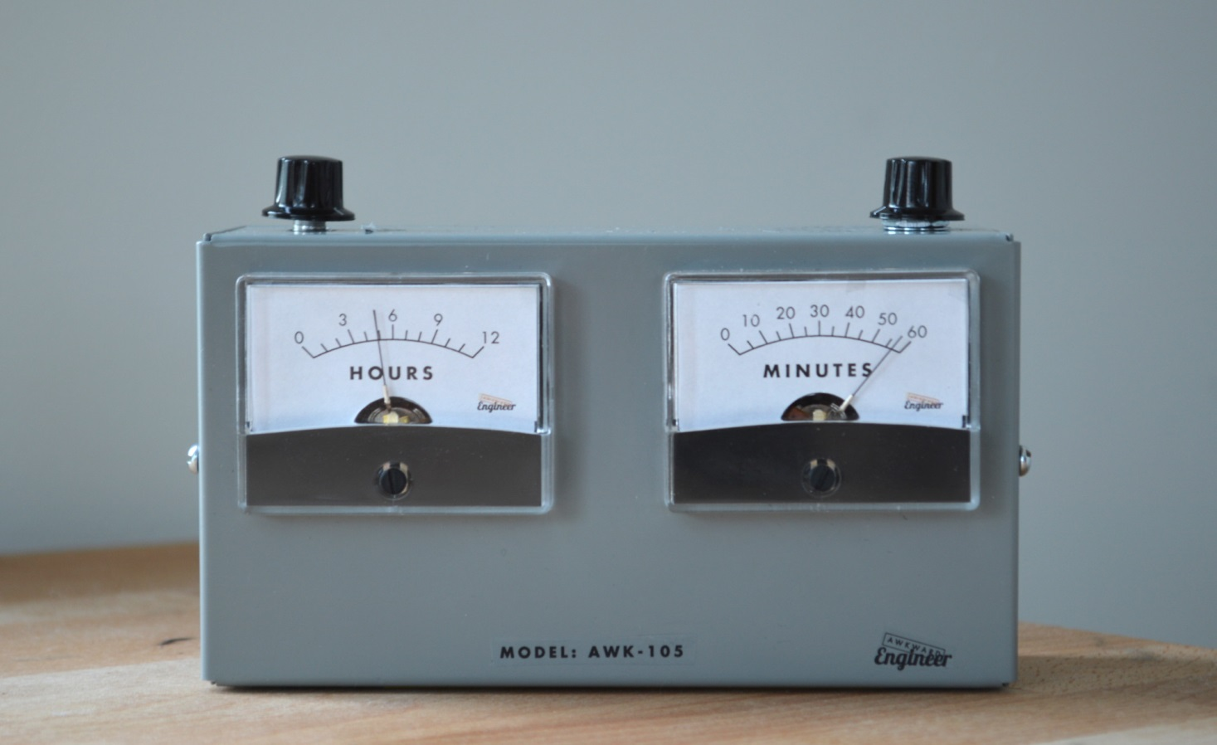
“Set” Knob for Quadrature Encoder
“Mode Select” Knob for Single Pole / Multi Throw

Slide 3
Stuff I Could Use Help With
Schematic Capture
Component selection / sourcing (I’ve started on the meter selection, but not individual components. You don’t happen to speak Chinese, do you?)
Design For Manufacture / Design For Assembly Support (some specific fab related questions)
Board Layout
Fab house selection / support

Slide 4
Adjust
Knob
Mode
Knob
Quadrature Encoder
external oscillator crystal
Single Pole, 4 Throw Switch (future proof is 5)
ANALOG IN
Test Jumper
Cal 1
Cal 2
Time
X-Factor
Set Alarm
micro
(prototype is an ATtiny85, porbably need an ATtiny84)
V_{cc}
GND
switch debounce
INTERUPT A
INTERUPT B
GND
resistor network
Alarm On/Off
Power conditioning
PWM OUT 1
USB / Power
PWM OUT 2
DIG OUT 1
DIG OUT 2
(see Note 3)
AM/PM Light
GND
Alarm Set Light
GND
Unpopulated components for future versions
(see Note 2)
Buffer / Voltage Boost (see Note 1)
NOTES
I originally used some 15V analog meters, which require a boost circuit and some buffering to convert the signal from the micro. I also found some 50μA meters, which won’t need the boost circuit. The mechanical parts of the meter act as a low pass filter on the PWM.
I want to have the option on the PCB to populate it with components I might use for a future version.
Power and programming over USB. Requires some bootloader stuff, too. (I did prototype work using a Digispark from http://digistump.com/products/1)
Hours Display
Minutes Display

Slide 5
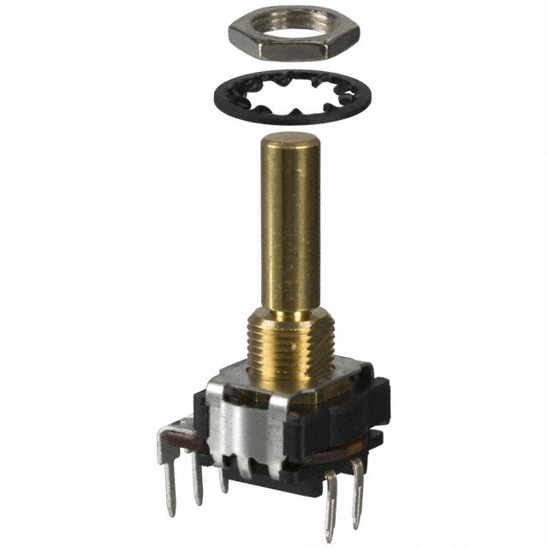
Encoder/ Switch Selection Notes
SOFT REQUIREMENT:
select shaft size of either ¼” or 6mm, but whatever you pick must be the same for both. (They fit a sourceable knob size)
SOFT REQUIREMENT:
“panel mount” style encoders and selection switches are easier
“panel mount” style switches only seem to come in through hole mounts. (FYI)

Slide 6
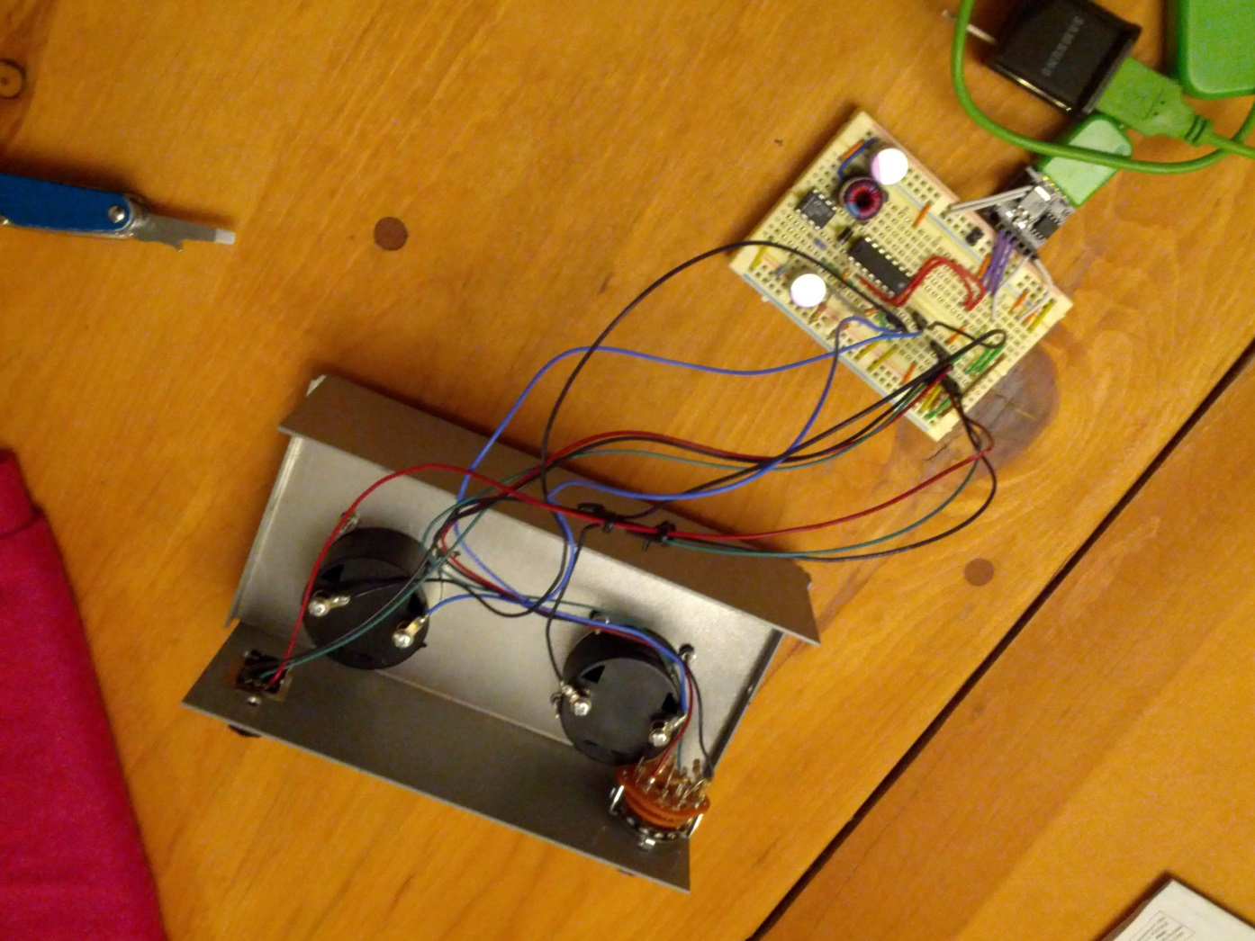
Design For Manufacure / Design For Assembly Discussion Points
This prototype is almost an example of what not to do:
Lots of hand soldered flying leads (think slow and expensive trained technicians)
A bunch of crimped screw terminals (slow and expensive)
screw terminals

Slide 7
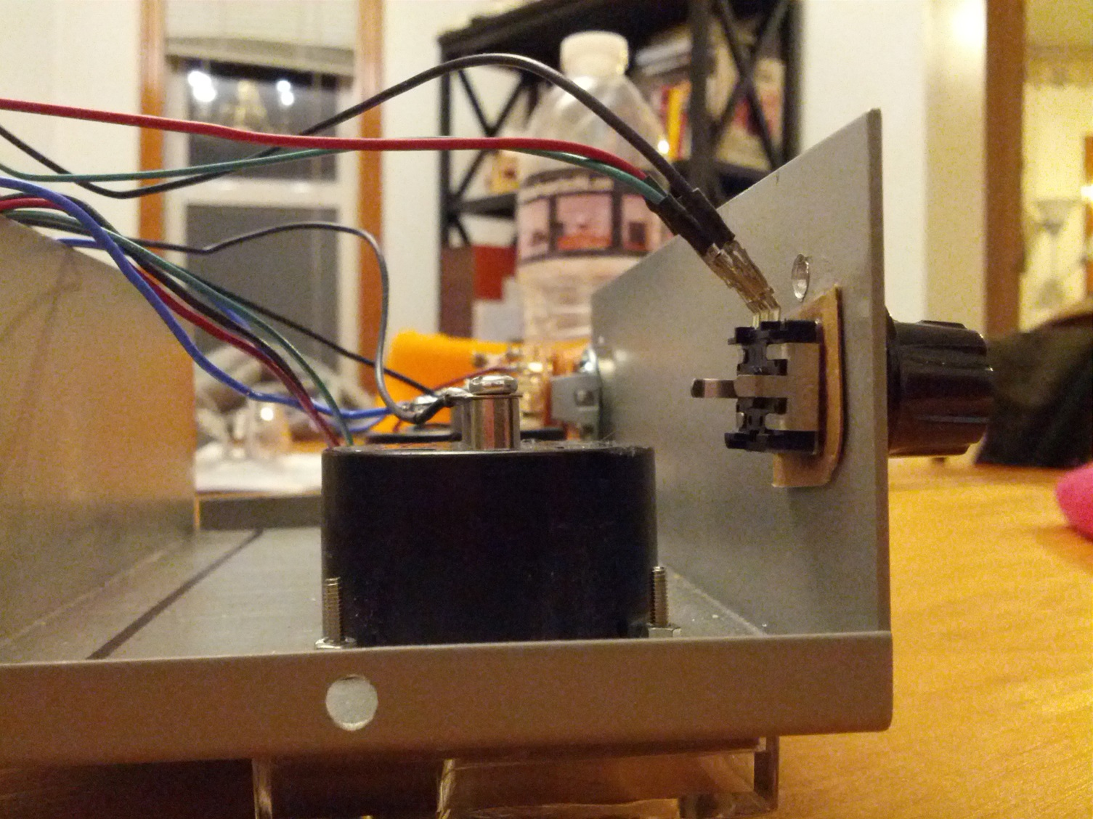
Design For Manufacture / Design For Assembly Discussion Points
Seems like a single board can allllllmost make it. Maybe with some standoffs and clever placement of right angle connectors?

Slide 8
Design For Manufacture / Design For Assembly Discussion Points
Idea #1
main PCB uses panel mount encoder & switch to attach to chassis
PCB connects all screw terminals (no crimped wires)
To USB bulkhead connector
Jumper assembly with headers. IS THIS HARD TO GET? Can you get it with polarized plugs that can’t be put in backwards?
Description | # of Operations | Cost estimate
Course panel mount screws | 2x | $.20
Fine screws | 4x | $.80
Jumper | 2x | $.05
 |  | $1.05

Slide 9

Design For Manufacture / Design For Assembly Discussion Points
Idea #2
main PCB uses panel mount encoder & switch to attach to chassis
To USB bulkhead connector
Description | # of Operations | Cost estimate
Course panel mount screws | 2x | $.20
Crimp terminal screws | 4x | $1.00
Jumper | 2x | $.05
 |  | $1.25
Header one side, ring terminal crimps the other

Slide 10
Design For Manufacture / Design For Assembly Discussion Points
vs.
If the Industrial Design changes and moves the knobs close together for a physically smaller board, does that save $$$?

Slide 11
Design For Manufacture / Design For Assembly Discussion Points
Seems like a single board can allllllmost make it. Maybe with some standoffs and clever placement of right angle connectors?

Slide 12
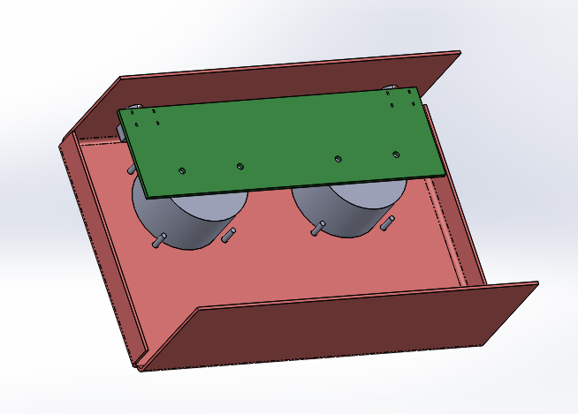
DFM CAD Model Study (1 of 2)
Single board screws to both meters and has panel mount selector switch and encoder

Slide 13
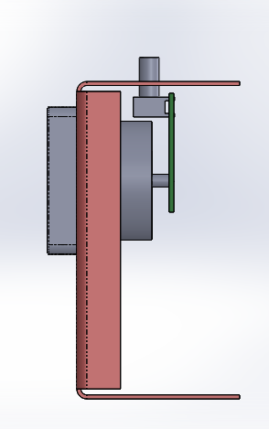
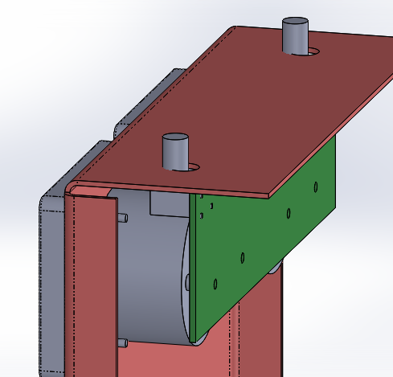
DFM CAD Model Study (2 of 2)
It looks like there is room to do this! The encoder/selector switch model is notional, but it looks like it could happen!

